Slide 1

Sesi 13 reading a text of holiday and learning about punctuation
Team English teaching unsia

Slide 2
LEARNING OBJECTIVES
After learning this session you will :
Able to understand about concept of reading a task and concept of punctuation in the text

Slide 3
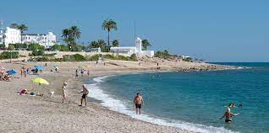
My holiday
My favourite holiday is the seaside. I want to do many things at the seaside like fishing, making sand castles, surfing or windsurfing.
My family wants to go to Mojacar in summer. We want to spend a week there in August in a hotel. It is the best month because it is hot and sunny.
My brother and I want to swim, but it is very difficult when it is windy and there are many waves. My father wants to fish on the rock and in a boat. My mother wants to read a book and sunbathe.

Slide 4
VOCABULARY
Seaside : tepi laut
Sand : pasir
Castle : kastil
Surfing : berselancar
Windsurfing : selancar angin
Mojacar : Place in Spain
Summer : musim panas
Spend : menghabiskan
Windy : berangin
Waves : ombak

Slide 5
What do you like to do on your holiday / traveling?
I like to take a photo
I like to cook in the kitchen
I like to sleep in a room
I like to buy souvenirs
I like to walk around the places
I like stay along in a beautiful places
I like to make a new friends
I like to taste the food
I like to swim in the sea
I like to climb
I like to sunbathe
I like to play sand build a castle
I like to spend my time with family
I like to spend my time with love

Slide 6
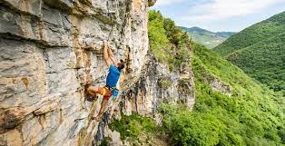
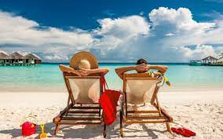

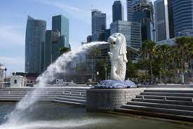


Where do you like to go on your holiday?

Slide 7
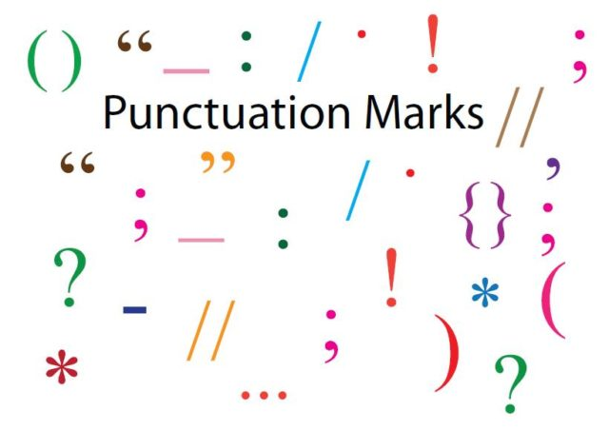
PUNCTUATION
Punctuation is a symbol to create and support meaning within a sentence or to break it up.

Slide 8
Symbol | Name of the punctuation | Meaning | Example
. | Full stop | Used at the end of the sentence | My brother is an army.
, | Comma | Used to denote a pause in a sentence | He was a wise, clever and old man
? | Question mark | Used at the of an interrogative sentence to form a question | How are you?
! | Exclamation mark | Used to denote shock, surprise, anger, or a raise voice | Wow! Today has been awesome
( ) | Brackets | Used to add extra information in a sentence | The two brothers (Riki and Rino) were learning how to play tennis
/ | Slash | Used to separate letters, numbers, words | Free ticket will be given to children/women only
- | Hyphen | Used to glue words together | It was only a five-minute wait
“ “ | Quotation mark | Used to that someone else has said it | “I work in Italy” said Katon
: | Colon | Used to indicate what is to follow next | You have two choices : finish the work today or lose the contract
; | Semi colon | Used to link independent clauses | My daughter is a teacher ; my son is a doctor

Slide 9
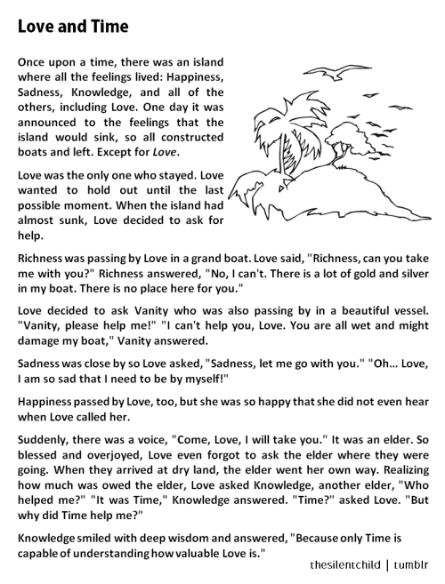
Practice reading: How many punctuation in the text ?

Slide 10
Exercise
There is no place like home
He was born on 25 07 1999
He needs two thirds of the votes
How beautiful this city is
Call me tomorrow I will give you my answer
I want to quack but I had no voice
What book will she write
I lost my phone a Samsung A5 yesterday during football training
I would have to pick up a solid coat winter in Minnosota is cold
How do you do said the gentleman

Slide 11
Answer
There is no place like home.
He was born on 25/07/1999
He needs two - thirds of the votes
How beautiful this city is!
Call me tomorrow; I will give you my answer
I want to quack, but I had no voice
What book will she write?
I lost my phone (a Samsung A5) yesterday during football training
I would have to pick up a solid coat: winter in Minnosota is cold
“How do you do?“ said the gentleman

Slide 12
Conclusion
When you write, not only your writing needs to be interesting but also to be correct.
Punctuation is an important part of writing correctly.
Mistakes in punctuation or ignoring punctuation marks can confuse the readers.

Slide 13


